Slide 1


Configure Subscriptions and Configure Azure Resource Manager Resources

Slide 2



Learning Objectives – Subscriptions and Azure RM
Identify Regions
Implement Azure Subscriptions
Identify Subscription Usage
Obtain a Subscription
Create Resource Groups
Determine Service Limits and Quotas
Create an Azure Resource Hierarchy
Apply Resource Tagging
Manage Costs
Learning Recap
Manage Azure identities and governance (20–25%): Manage subscriptions and governance
Configure resource locks
Apply and manage tags on resources
Manage resource groups
Manage subscriptions
Manage costs by using alerts, budgets, and Azure Advisor recommendations
Configure management groups

Slide 3
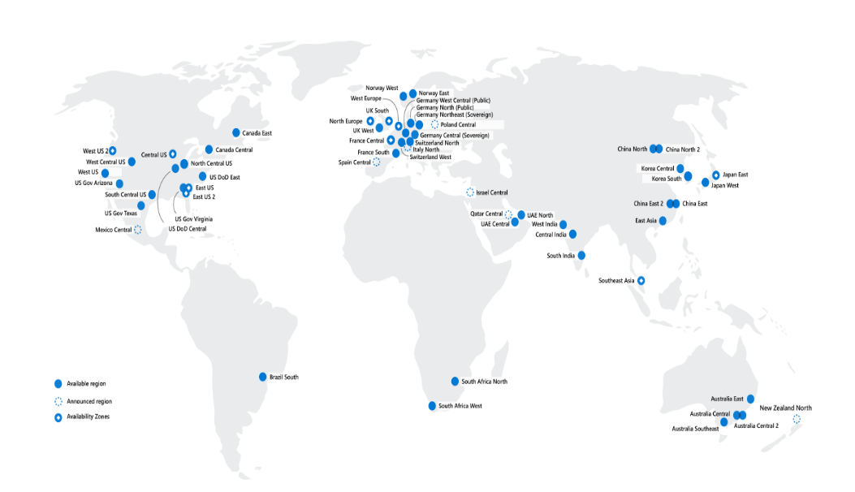
Identify Regions
A region represents a collection of datacenters
Provides flexibility and scale
Preserves data residency
Select regions close to your users
Be aware of region deployment availability
There are global services that are region independent
Worldwide there are 60+ regions
representing 140 countries
Most regions are paired for high availability
Notes:
A list of regions and their locations is available at https://azure.microsoft.com/global-infrastructure/locations/
Here is a link to the list of regional pairs: https://learn.microsoft.com/azure/reliability/cross-region-replication-azure#azure-cross-region-replication-pairings-for-all-geographies
Microsoft datacenters animation - https://datacenters.microsoft.com/globe/explore
Virtual datacenter tour - https://datacenters.microsoft.com/globe/explore/datacenter

Slide 4
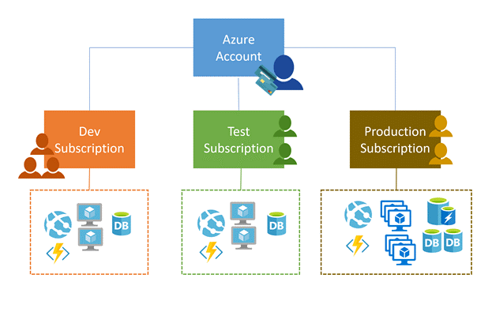
Implement Azure Subscriptions
Only identities in Entra ID, or in a directory that is trusted by Entra ID, can create a subscription
Logical unit of Azure services that is linked to an Azure account
Security and billing boundary*
Notes:
*Clarification on the last bullet - OnlyiIdentities in Microsoft Entra ID or in a directory that is trusted by Entra ID (such as a work or school organization) can create a Subscription. For example, Account Owner role can be used to create a Subscription in an Enterprise Agreement.
Create an additional Azure subscription - https://docs.microsoft.com/azure/cost-management-billing/manage/create-subscription
Change your Azure subscription to a different offer - https://docs.microsoft.com/azure/cost-management-billing/manage/switch-azure-offer
Subscription considerations and recommendations - https://learn.microsoft.com/azure/cloud-adoption-framework/ready/landing-zone/design-area/resource-org-subscriptions
Organize and manage multiple Azure subscriptions - https://learn.microsoft.com/azure/cloud-adoption-framework/ready/azure-best-practices/organize-subscriptions
✔️ Do you know how many subscriptions your organization has?

Slide 5
Identify Subscription Usage
Subscription | Usage
Free | Includes a $200 credit for the first 30 days, free limited access for 12 months
Pay-As-You-Go | Charges you monthly
CSP | Agreement with possible discounts through a Microsoft Cloud Solutions Provider Partner – typically for small to medium businesses
Enterprise | One agreement, with discounts for new licenses and Software Assurance – targeted at enterprise-scale organizations
Student | Includes $100 for 12 months – must verify student access
Notes:
Credit card information is used for identity verification only. You won’t be charged for any services until you upgrade.

Slide 6
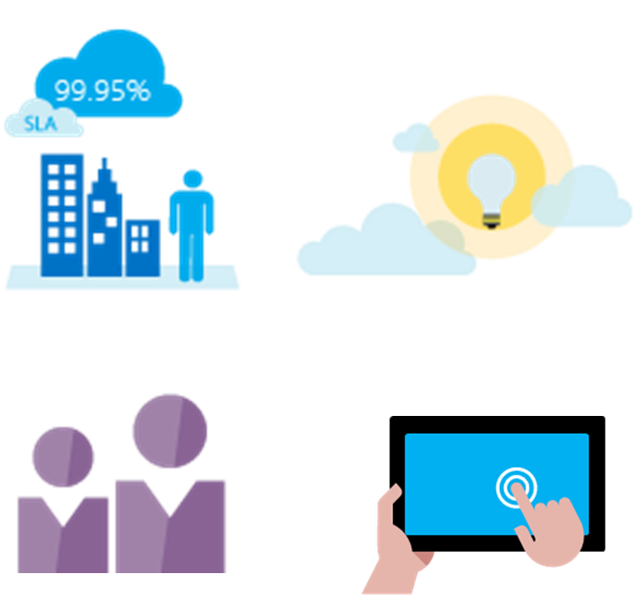
Obtain a Subscription
Enterprise Agreement customers make an upfront monetary commitment and consume services throughout the year
Resellers provide a simple, flexible way to purchase cloud services
Partners can design and implement your Azure cloud solution
Personal free account that you can start using immediately
Notes:
Subscription decision guide - https://docs.microsoft.com/azure/cloud-adoption-framework/decision-guides/subscriptions/
Explore flexible purchasing options for Azure - https://azure.microsoft.com/pricing/purchase-options/
✔️ Which subscription model are you most interested in?

Slide 7


Create Resource Groups
Resources can only exist in one resource group
Resources grouped
(Web + DB, VM, Storage) in one group
Groups can have resources of many different types (services) and from many different regions
OR
Groups cannot be renamed or nested
Web and DB resource group
Virtual machine resource group
Storage resource group
You can move resources between groups
Notes:
Manage Azure Resource Manager resource groups by using the Azure portal - https://docs.microsoft.com/azure/azure-resource-manager/management/manage-resource-groups-portal
There is an excellent Learn module, Use Azure resources, https://learn.microsoft.com/training/modules/use-azure-resource-manager/. This covers the Azure Resource Manager, resources, limits, locks, and groups.

Slide 8
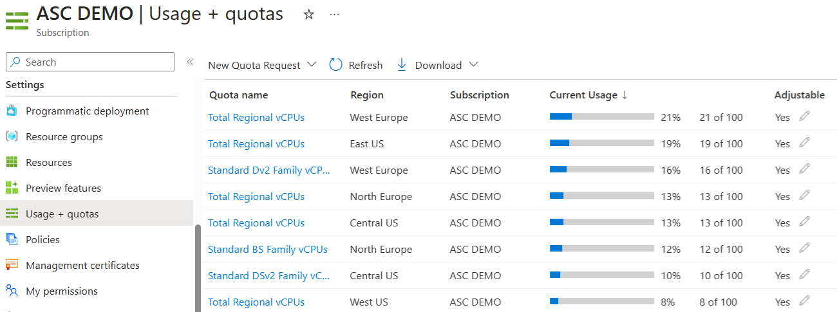
Determine Service Limits and Quotas
Resources have a default limit - a subscription quota
Helpful to track current usage, and plan for future use
You can open a free support case to increase limits to published maximums
Notes:
Azure subscription and service limits, quotas, and constraints - https://docs.microsoft.com/azure/azure-resource-manager/management/azure-subscription-service-limits

Slide 9
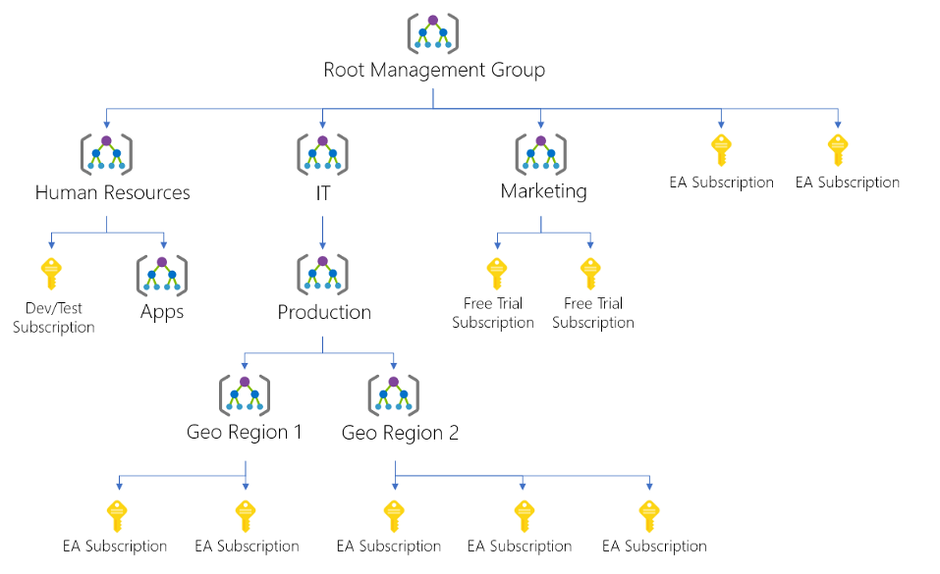
Create an Azure Resource Hierarchy
Management groups provides a level of scope above subscriptions
Target policies and spend budgets across subscriptions.
Implement Compliance and Cost Reporting for Different Teams
* To prevent changes, apply resource locks at the subscription, resource group, or resources level
Notes:
Create management groups for resource organization and management - https://docs.microsoft.com/azure/governance/management-groups/create
Manage your resources with management groups - https://docs.microsoft.com/azure/governance/management-groups/manage

Slide 10
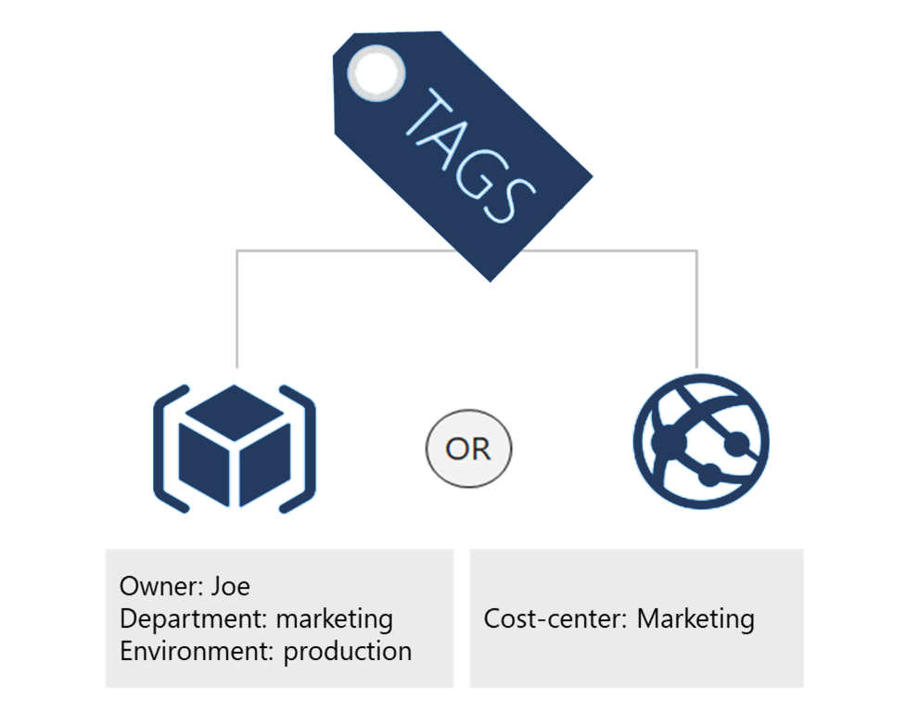
Apply Resource Tagging
Provides metadata for your Azure resources
Logically organizes resources
Consists of a name-value pair
Very useful for rolling up billing information
Notes:
Resource naming and tagging decision guide - https://docs.microsoft.com/azure/cloud-adoption-framework/decision-guides/resource-tagging
✔️ If you need to create a lot of tags you will want to do that programmatically. You can use PowerShell or the CLI.

Slide 11
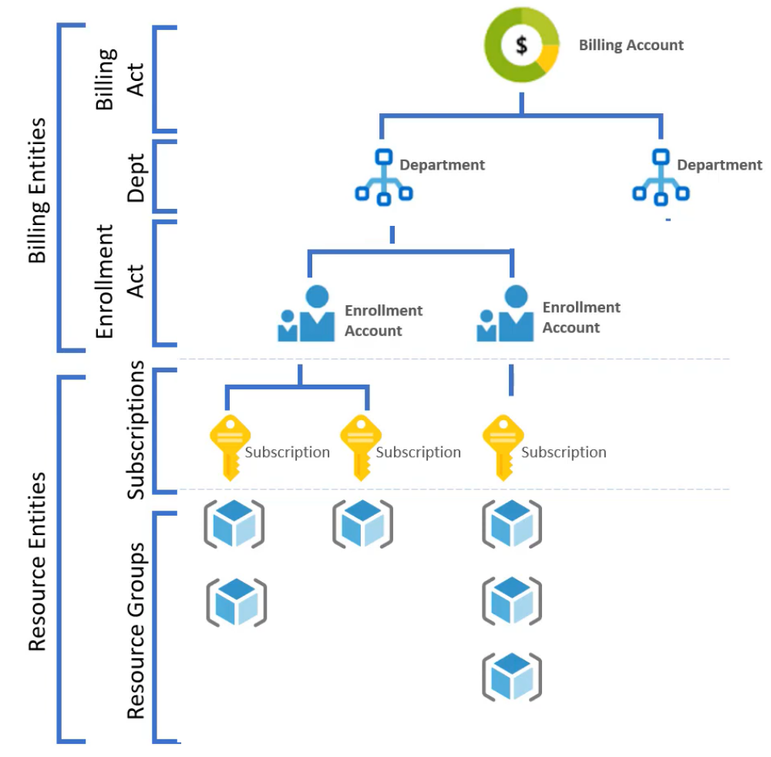
Manage Costs
Costs are resource-specific
Usage costs may vary between locations
Costs for inbound and outbound data transfers differ
Pre-pay with Azure reserved instances
Use your on-premises licenses with Azure Hybrid Benefit
Optimize costs with alerts, budgets, and Azure Advisor recommendations
Notes:
Azure usage charges - https://docs.microsoft.com/azure/billing/billing-understand-your-invoice
There are six primary factors affecting costs:
Resource Type: Costs are resource-specific, so the usage that a meter tracks and the number of meters associated with a resource depend on the resource type.
Services: Azure usage rates and billing periods can differ between Enterprise, Web Direct, and CSP customers.
Location: The Azure infrastructure is globally distributed, and usage costs might vary between locations that offer Azure products, services, and resources.
Bandwidth: Some inbound data transfers are free, such as data going into Azure datacenters. For outbound data transfers, such as data going out of Azure datacenters, pricing is based on Zones.
Azure Reservations: Azure Reservations allow you to prepay for one-year or three-years of virtual machine or SQL Database compute capacity. Pre-paying will allow you to get a discount on the resources you use. Azure reservations can significantly reduce your virtual machine or SQL database compute costs — up to 72 percent on pay-as-you-go prices with one-year or three-year upfront commitment. Reservations provide a billing discount and don't affect the runtime state of your virtual machines or SQL databases.
Azure Hybrid Benefit: If you already have Windows Server or SQL Server licenses in your on-premises deployments, you can use the Azure Hybrid Benefit program to save in Azure. With the Windows Server benefit, each license covers the cost of the OS (up to two virtual machines), and you only pay for base compute costs. You can use existing SQL Server licenses to save up to 55 percent on vCore-based SQL Database options. Options include SQL Server in Azure Virtual Machines and SQL Server Integration Services.

Slide 12
Configure Azure Policy

Slide 13
Implement Azure Policies
A service to create, assign, and manage policies
Usage Cases
Allowed resource types – Specify the resource types that your organization can deploy
Allowed virtual machine SKUs – Specify a set of virtual machine SKUs that your organization can deploy
Allowed locations – Restrict the locations your organization can specify when deploying resources
Require tag and its value – Enforces a required tag and its value
Azure Backup should be enabled for Virtual Machines – Audit if Azure Backup service is enabled for all Virtual machines
Runs evaluations and scans for non-compliant resources
Advantages:
Enforcement and compliance
Apply policies at scale
Remediation
Notes:
What is Azure Policy? - https://docs.microsoft.com/azure/governance/policy/overview
Quickstart: Create a policy assignment to identify non-compliant resources - https://docs.microsoft.com/azure/governance/policy/assign-policy-portal

Slide 14




Create Azure Policies
Define and create
Scope and assign
Assess compliance
Policy Initiative
Policy Definition(s)
Notes:
Walk-through the Tutorial: Create and manage policies to enforce compliance - https://docs.microsoft.com/azure/governance/policy/tutorials/create-and-manage
Or do the Demonstration (in the MCT DLC).
Or just walk through the slides.
Apply and monitor infrastructure standards with Azure Policy (Learn) - https://docs.microsoft.com/learn/modules/intro-to-governance/
The next topics step you through creating an Azure policy.
✔ Even if you have only a few Policy Definitions, we recommend creating an Initiative Definition.

Slide 15
Demonstration – Azure Policy
Assign a policy
Create and assign an initiative definition
Check for compliance
Check for remediation tasks
Remove your policy and initiative
Notes:
Tutorial: Build policies to enforce compliance - Azure Policy - https://docs.microsoft.com/azure/governance/policy/tutorials/create-and-manage

Slide 16
Configure Role Based Access Control
(RBAC)

Slide 17
Compare Azure RBAC Roles to Entra ID Roles
RBAC roles provide fine-grained access management
Azure RBAC roles | Entra ID roles
Manage access to Azure resources | Manage access to Entra ID objects
Scope can be specified at multiple levels | Scope is at the Tenant level
Role information can be accessed in the Azure portal, Azure CLI, Azure PowerShell, Azure Resource Manager templates, REST API | Role information can be accessed in Azure portal, Microsoft 365 admin portal, Microsoft Graph, Azure Active Directory PowerShell for Graph
Notes:
You may want to cover this slide after discussing the next 3 slides which explain what RBAC is.

Slide 18
Create a Role Definition
Collection of permissions that lists the operations that can be performed
Contributor
Owner
Contributor
Reader
…
Backup Operator
Security Reader
User Access Administrator
Virtual Machine Contributor
"Actions": [
"*"
],
"NotActions" : [
"Authorization/*/Delete",
"Authorization/*/Write",
"Authorization/elevateAccess/Action"
],
"DataActions" : [],
"NotDataActions": [],
"AssignableScopes" : [
"/"
]
Built-in
Reader Support Tickets
Virtual Machine Operator
Custom
Notes:
List role definitions in Azure RBAC - https://docs.microsoft.com/azure/role-based-access-control/role-definitions-list
Create custom roles for Azure resources with role-based access control - https://docs.microsoft.com/learn/modules/create-custom-azure-roles-with-rbac/
Extra slide at the end on built-in roles - Determine Azure RBAC Roles.

Slide 19








Create a Role Assignment
Process of binding a role definition to a user, group, or service principal at a scope for the purpose of granting access
1
Security principal
User
Group
Service principal
2
Role definition
Role assignment
3
Scope
Owner
Contributor
Reader
…
Backup Operator
Security Reader
Contributor
"Actions": [
"*"
],
"NotActions": [
"Auth/*/Delete",
"Auth/*/Write",
"Auth/elevate"
]
Management group
Marketing group
Subscription
Resource group
Pharma-sales
Resource group
Reader Support Tickets
Virtual Machine Operator
Contributor
Resource
Notes:
Add or remove role assignments using Azure RBAC and the Azure portal - https://docs.microsoft.com/azure/role-based-access-control/role-assignments-portal
Explain that the role assignment completes the process of implementing RBAC and combining service principals, a role definition, and a scope.

Slide 20






Apply RBAC Authentication
Entra ID
Admin roles
Tenant
Global admin
Application admin
Application developer
Billing admin
…
Global admin/User access admin (elevated access)
Root
Azure RBAC
roles
Root management group
Owner
Contributor
Reader
User access admin
…
Management
group
Subscription
Azure RBAC
roles
Resource group
Azure account
Owner
Contributor
Reader
User access admin
…
Resource
Notes:
Manage access to an Azure subscription by using Azure role-based access control - https://docs.microsoft.com/learn/modules/manage-subscription-access-azure-rbac/3-elevate-your-access-user-access-admin

Slide 21
Demonstration – Azure RBAC
Locate the Access Control blade
Review role permissions
Add a role assignment
Notes:
Tutorial: Grant a user access to Azure resources using the Azure portal - https://docs.microsoft.com/azure/role-based-access-control/quickstart-assign-role-user-portal
Quickstart: Check access for a user to Azure resources - https://docs.microsoft.com/azure/role-based-access-control/check-access

Slide 22
Lab 02a - Manage Subscriptions and RBAC
Lab 02b - Manage Governance via Azure Policy

Slide 23
Lab 02a – Manage Subscriptions and Azure RBAC
Job Skills
In this lab, you learn about role-based access control.
You learn how to use permissions and scopes to control what actions identities can and cannot perform.
You also learn how to make subscription management easier by using management groups.
Task 1: Implement management groups.
Task 2: Review and assign a built-in Azure role.
Task 3: Create a custom RBAC role.
Task 4: Monitor role assignments with the Activity Log.
Notes:
Use this lab to introduce students to management groups and RBAC. There are two labs in this module, 2a and 2b.
Lab 02a - https://microsoftlearning.github.io/AZ-104-MicrosoftAzureAdministrator/Instructions/Labs/LAB_02a_Manage_Subscriptions_and_RBAC_Entra.html

Slide 24


Lab 02a – Architecture diagram
Task 2
+
Built-in roles
Virtual Machine Contributor
Task 4
Task 1
az104-mg1
Help Desk Group
Activity Log
Task 3
Custom roles
Custom Support Request
+

Slide 25
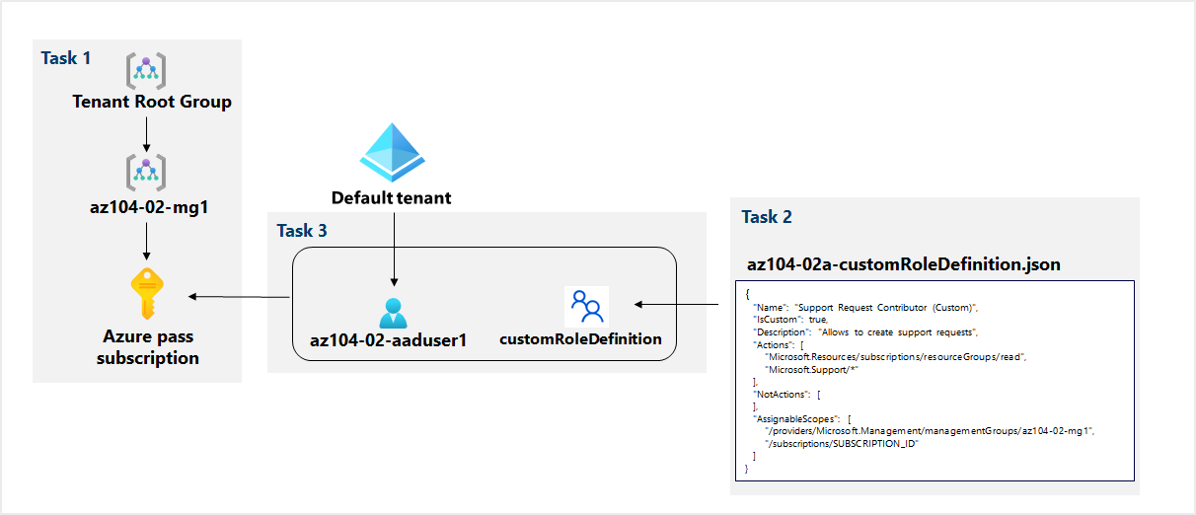
Lab 02a – Architecture diagram (interactive lab simulation)
Notes:
This is the architecture diagram for the interactive lab simulation, if you want to review that.

Slide 26
Lab 02b – Manage Governance via Azure Policy
Job Skills
In this lab, you learn how to implement your organization’s governance plans.
You learn how Azure policies can ensure operational decisions are enforced across the organization.
You learn how to use resource tagging to improve reporting.
Task 1: Create and assign tags via the Azure portal.
Task 2: Enforce tagging via an Azure Policy.
Task 3: Apply tagging via an Azure Policy.
Task 4: Configure and test resource locks.
Notes:
Use this lab to introduce Azure policy, tagging, and resource locks.
Lab 02b - https://microsoftlearning.github.io/AZ-104-MicrosoftAzureAdministrator/Instructions/Labs/LAB_02b-Manage_Governance_via_Azure_Policy.html

Slide 27




Lab 02b – Architecture diagram
Task 1
Task 2
Azure policy
Require a tag and its value on resources
Resource Group
x
Name: Cost Center
Value: 000
New Storage Account without the tag
Task 4
Task 3
Azure policy
Inherit a tag from the resource group if missing – remediation
Resource Group

New Storage Account - policy adds the tag

Slide 28
Lab 02b – Architecture diagram (interactive lab simulation)
Task 1
Name: Role
Value: Infra
Task 2
Cloud Shell Storage
Resource Group
Azure policy
Require a tag and its value on resources
Cloud Shell Storage Account
Task 3
Azure policy
Inherit a tag from the resource group if missing
New Storage Account
Notes:
This is the architecture diagram for the interactive lab simulation, if you want to review that.

Slide 29
Thank You!

